Slide 1
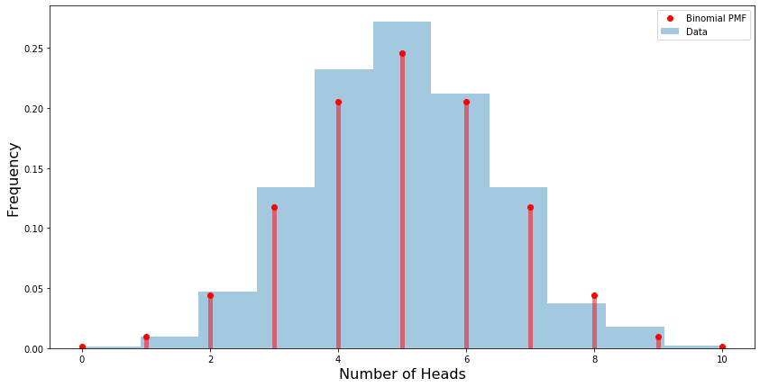
DISCRETE DISTRIBUTIONS: BINOMIAL
Binomial distribution: occurrence of events – some # of trials, scenario has two outcomes – event either succeeds or fails
Cliché example: flipping a coin - heads or tails?
Assumptions for binomial distribution:
(1) Occurrence probability is ~constant
Issue: atmospheric phenomena whose probability changes – diurnal, season
(2) Occurrences are independent
Issue: day-to-day dependence in some events, like precipitation events
Flipping a set of 10 coins 1000 times – how many heads would you get in the set of 10 coins?
Notes:
Solution: consider periods with ~ constant occurrence probability
Solution: use “Markov chain” stochastic process instead

Slide 2
DISCRETE DISTRIBUTIONS: BINOMIAL
Parameters: probability of successful event; number of “trials”
Physical examples
If a lake freezes or not
If a tornado forms or not
Flipping a set of 10 coins 1000 times – how many heads would you get in the set of 10 coins?
Notes:
Solution: consider periods with ~ constant occurrence probability
Solution: use “Markov chain” stochastic process instead

Slide 3
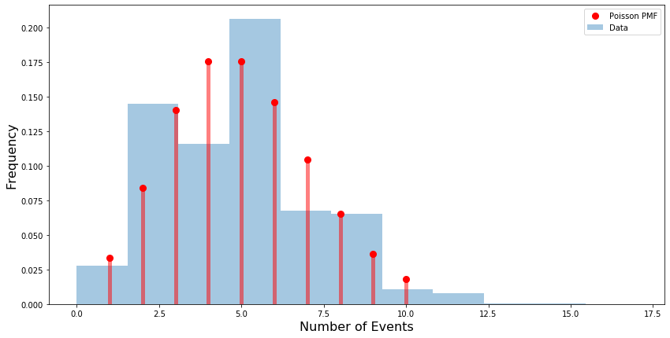
DISCRETE DISTRIBUTIONS: POISSON
Poisson distribution: number of discrete events that happen in some type of series – count
Often a series over time - # of thunderstorms that occur in Illinois in X amount of time
But can be a series over space – distribution of hail over a small area
Assumptions:
(1) Events happen randomly, but with a ~constant average rate
(2) Events in series are ~ independent
Good rule of thumb: if very low probability that you’d get two events happening simultaneously
Average occurrence rate = 5 events in X time

Slide 4
DISCRETE DISTRIBUTIONS: POISSON
Parameters: average occurrence rate
Physical examples:
earthquake frequency
landslide events
tornado counts
number of hurricane landfalls
Average occurrence rate = 5 events in X time

